Slide 1
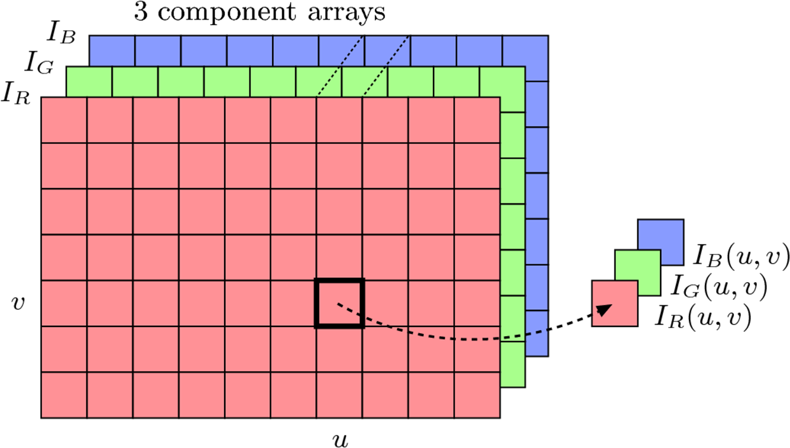
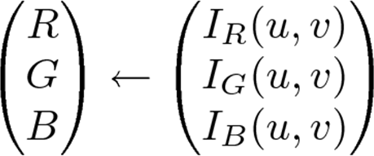
True Color: Component Ordering
Colors in 3 separate arrays of similar length
Retrieve same location (u,v) in each R, G and B array

Slide 2
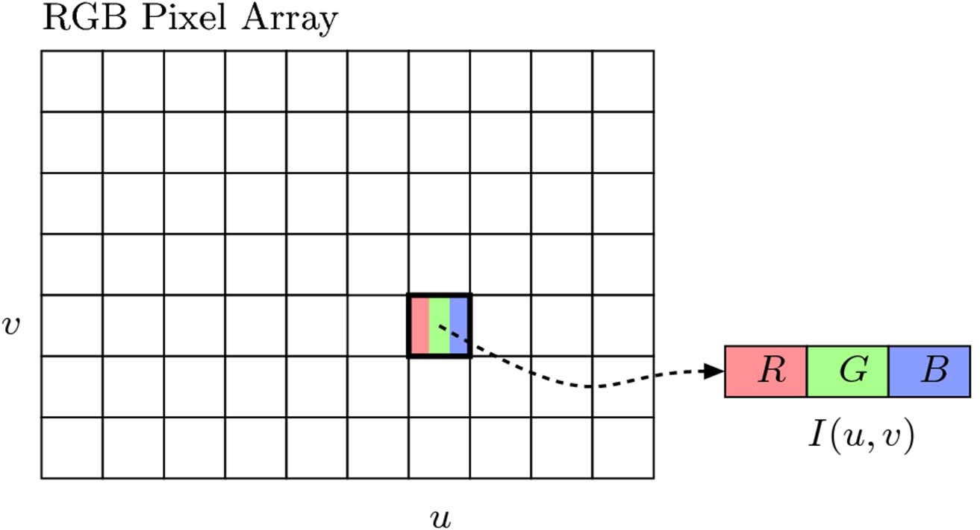
True Color: Packed Ordering
Component (RGB) values representing a pixel’s color is packed together into single element

Slide 3
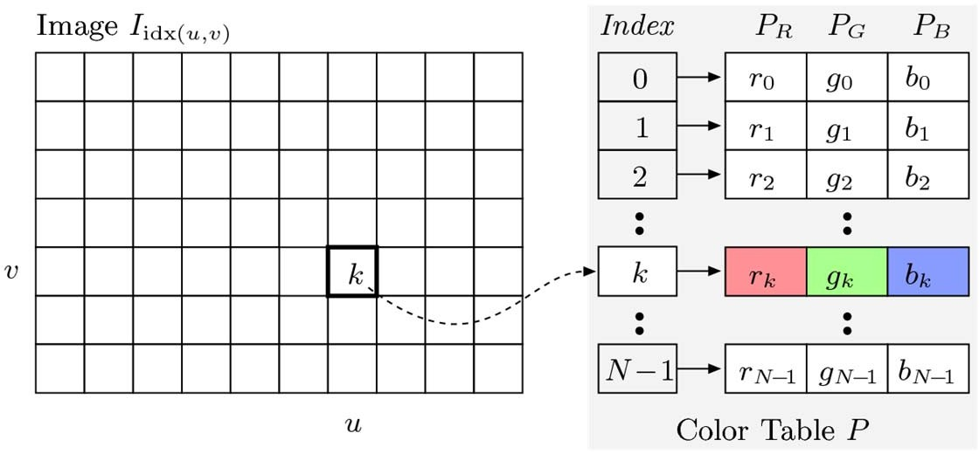
Indexed Images
Permit only limited number of distinct colors (N = 2 to 256)
Used in illustrations or graphics containing large regions with same color
Instead of intensity values, image contains indices into color table or palette
Palette saved as part of image
Converting from true color to indexed color requires quantization

Slide 4
Color Images in ImageJ
ImageJ supports 2 types of color images
RGB full‐color images (24‐bit “RGB color”),
packed order
Supports TIFF, BMP, JPEG, PNG and RAW file formats
Indexed images (“8‐bit color”)
Up to 256 colors max (8 bits)
Supports GIF, PNG, BMP and TIFF (uncompressed) file formats
See section 12.1.2 of Burger & Burge

Slide 5
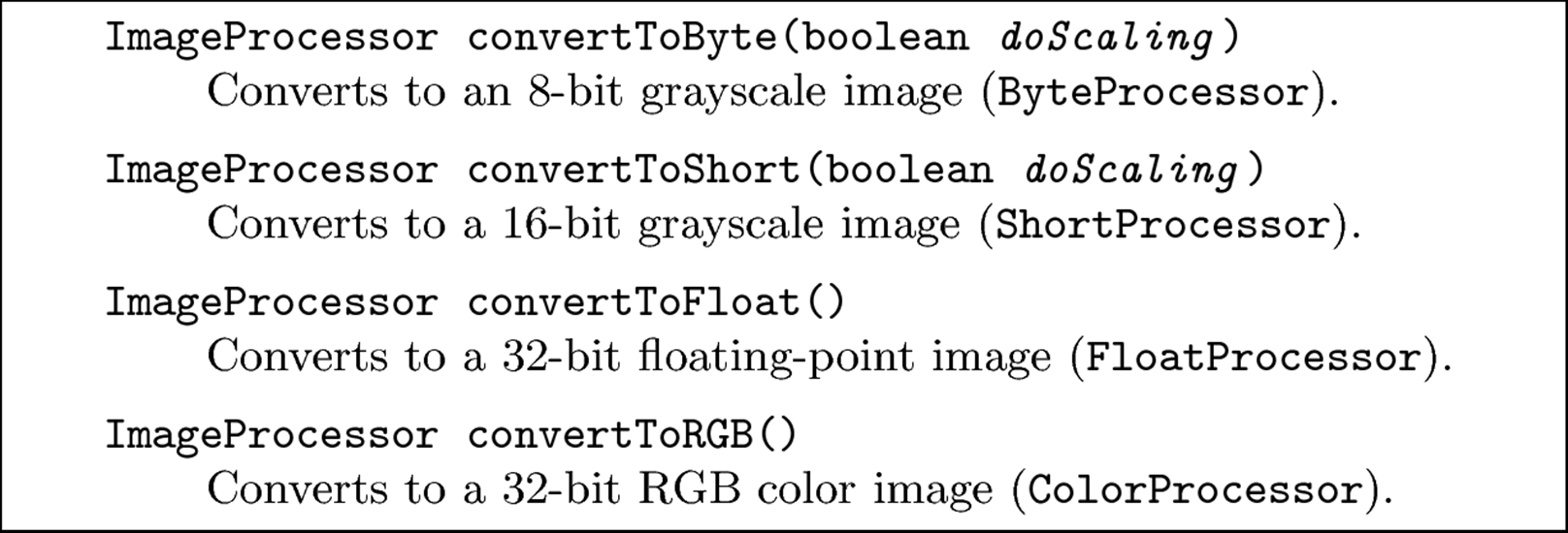
Color Image Conversion in ImageJ
Methods for converting between different types of color and grayscale image objects
Note: if doScaling is true, pixel values scaled to maximum range of new image

Slide 6
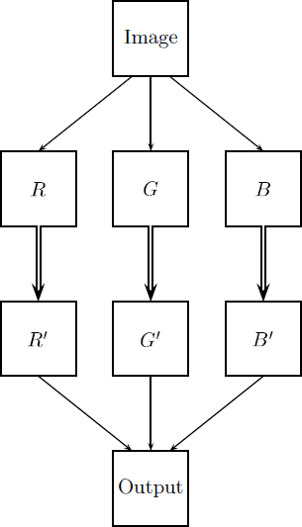
General Strategies for Processing Color Images
Strategy 1: Process each RGB matrix separately

Slide 7
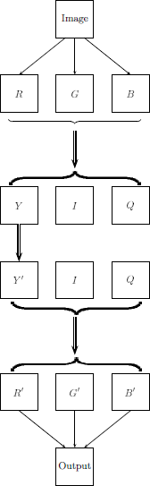
General Strategies for Processing Color Images
Strategy 2: Compute luminance (weighted average of RGB), process intensity matrix

Slide 8
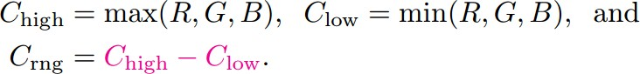
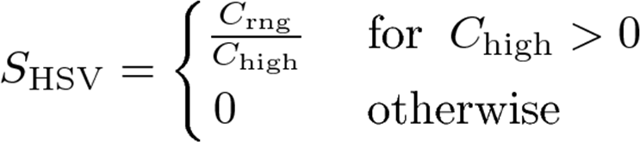

RGB to HSV Conversion
Define the following values
Find saturation of RGB color components (C_{max}= 255)
And luminance value

Slide 9
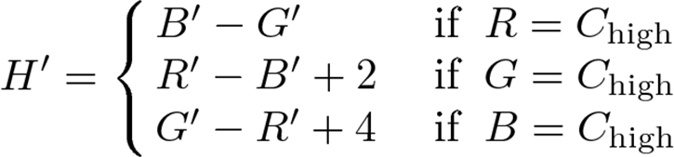
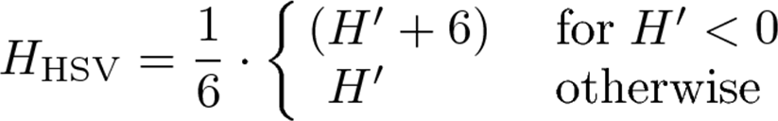
RGB to HSV Conversion
Normalize each component using
Calculate preliminary hue value H’ as
Finally, obtain final hue value by normalizing to interval [0,1]

Slide 10
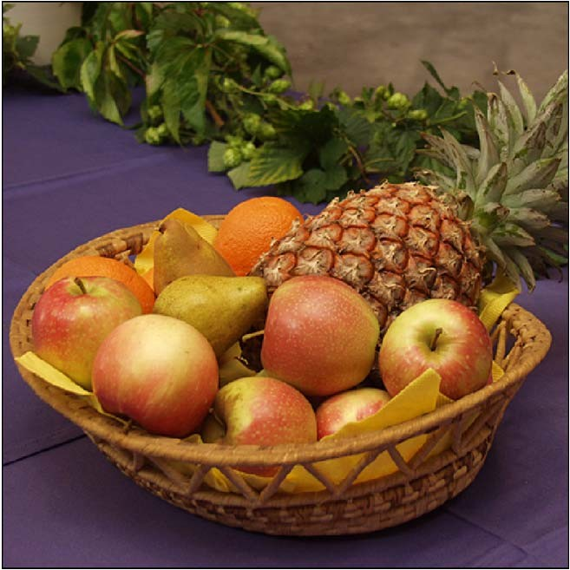
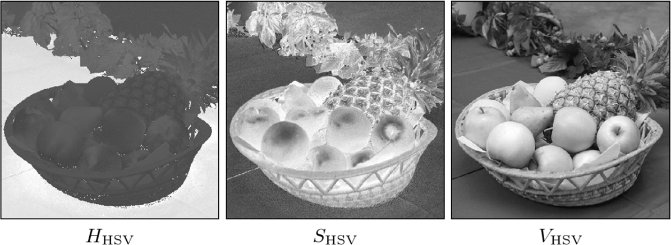
Example: RGB to HSV Conversion
Original RGB image
HSV values in grayscale

Slide 11
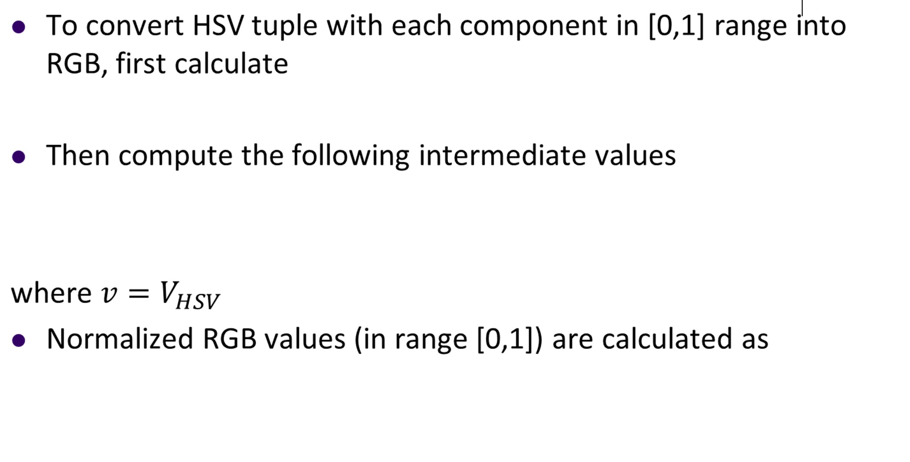
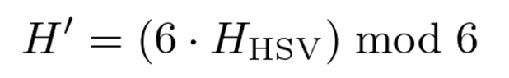
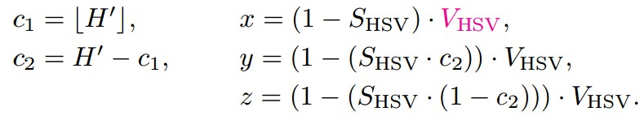
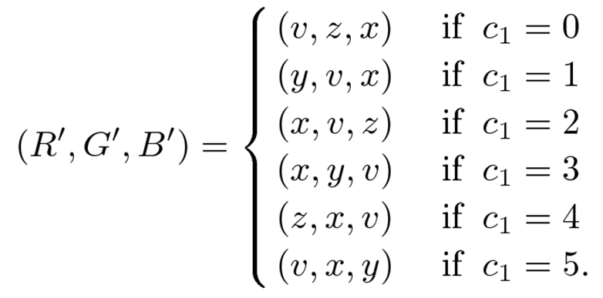
HSV to RGB Conversion
●

Slide 12
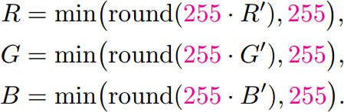
HSV to RGB Conversion
RGB Components can be scaled to whole numbers in range [0,255] as

Slide 13

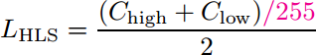
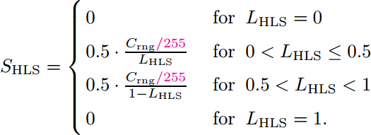
RGB to HLS Conversion
Compute Hue same way as for HSV model
Then compute the other 2 values as:

Slide 14
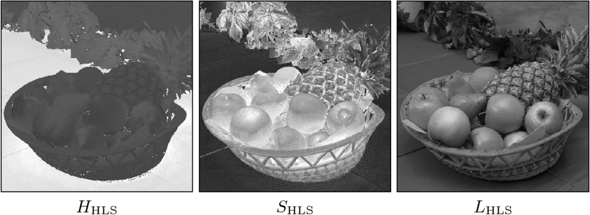
Example RGB to HLS Conversion
Original RGB image
HLS values in grayscale

Slide 15
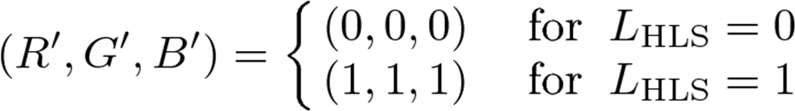
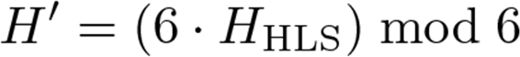
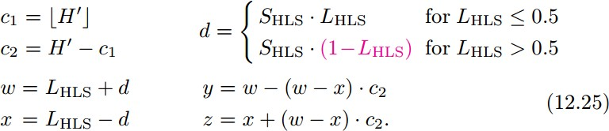
HLS to RGB Conversion
Assuming H, L and S in [0,1] range
Otherwise, calculate
Then calculate the values

Slide 16
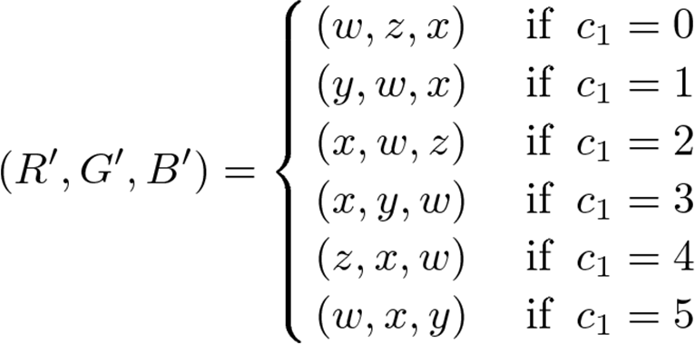
HLS to RGB Conversion
Assignment of RGB values is done as follows

Slide 17
TV Color Spaces – YUV, YIQ, YC_{b}C_{r}
YUV, YIQ: color encoding for analog NTSC and PAL
YC_{b}C_{r}: Digital TV encoding
Key common ideas:
Separate luminance component Y from 2 chroma components
Instead of encoding colors, encode color differences between components (maintains compatibility with black and white TV)

Slide 18
YUV
Basis for color encoding in analog TV in north america (NTSC) and Europe (PAL)
Y components computed from RGB components as
UV components computed as:

Slide 19
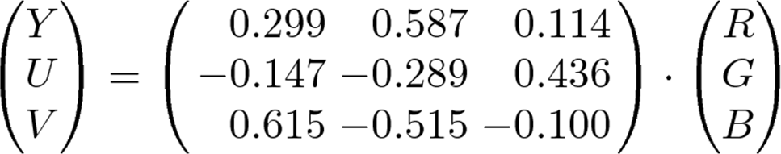
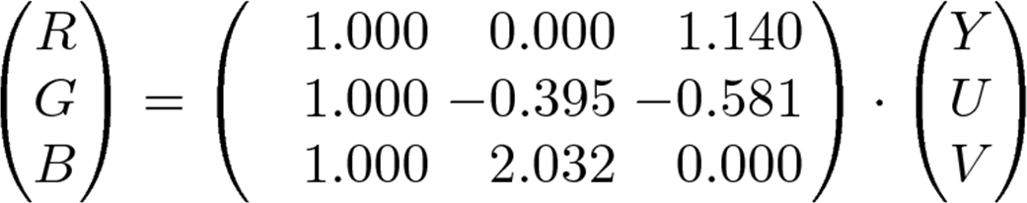
YUV
Entire transformation from RGB to YUV
Invert matrix above to transform from YUV back to RGB

Slide 20
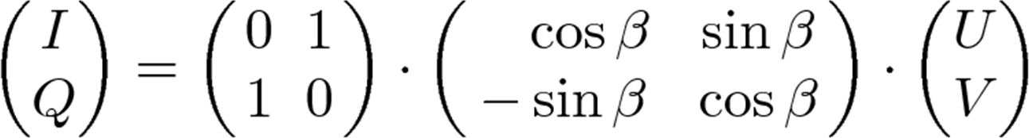
YIQ
Original NTSC used variant of YUV called YIQ
Y component is same as in YUV
Both U and V color vectors rotated and mirrored so that
2D rotation matrix
where β = 0.576 (33 degrees)

Slide 21
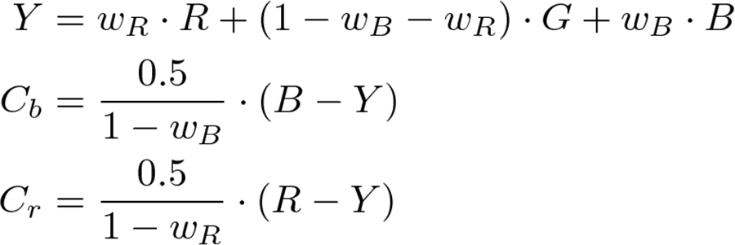
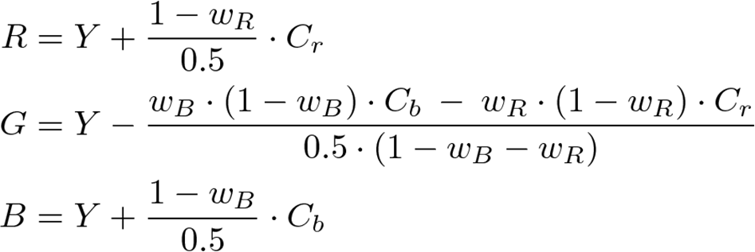
YC_{b}C_{r}
Internationally standardized variant of YUV
Used for digital TV and image compression (e.g. JPEG)
Y, C_{b}, C_{r} components calculated as
Inverse transform from YC_{b}C_{r} to RGB

Slide 22
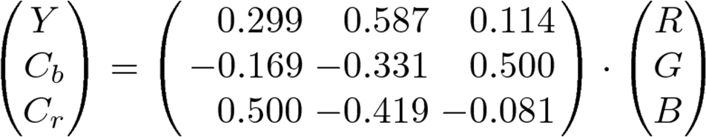
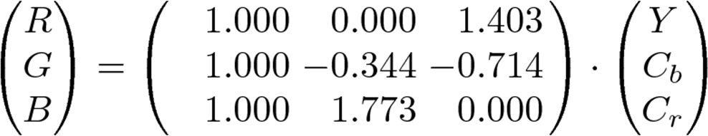
YC_{b}C_{r}
ITU recommendation BT.601 specifies values:
w_{R} = 0.299, w_{B} = 0.114, w_{G} = 1 – w_{B} – w_{R} = 0.587
Thus the transformation
And the inverse transformation becomes

Slide 23
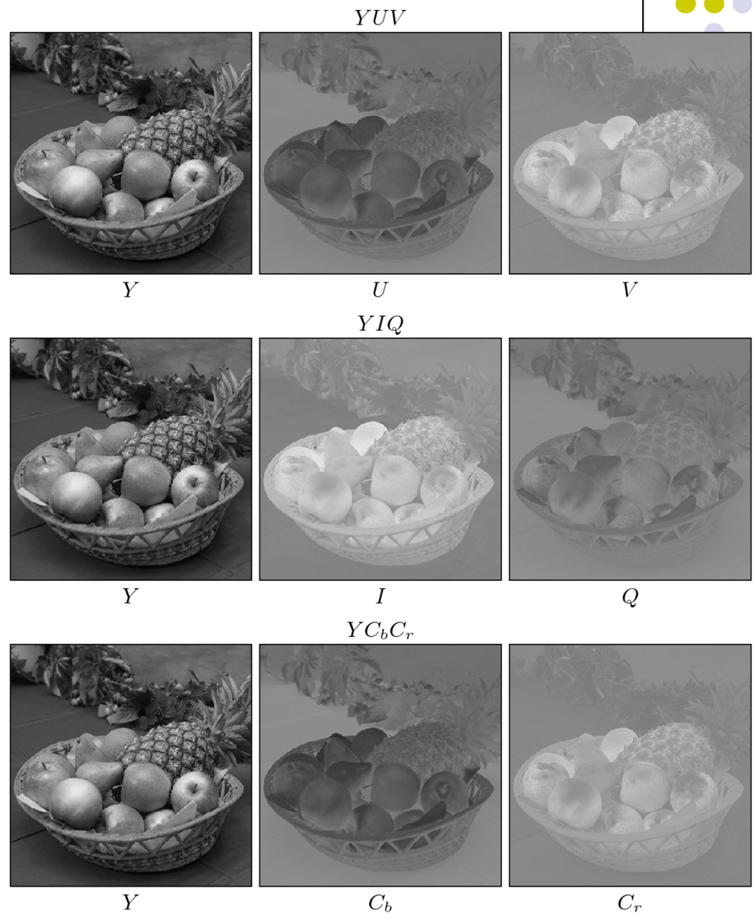
Comparing YUV, YIQ and YC_{b}C_{r}
Y values are identical in all 3 color spaces

Slide 24
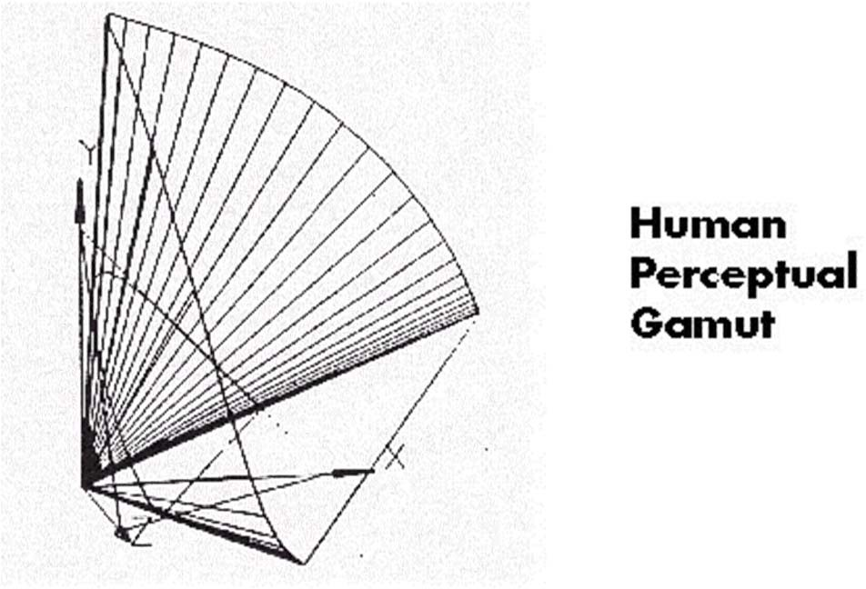
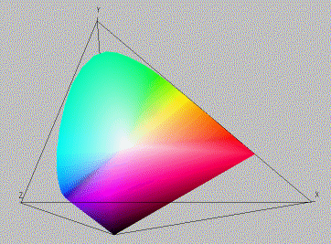
CIE Color Space
The gamut of all colors perceivable is thus a three‐dimensional shape in X,Y,Z
Color = X’X + Y’Y + Z’Z

Slide 25
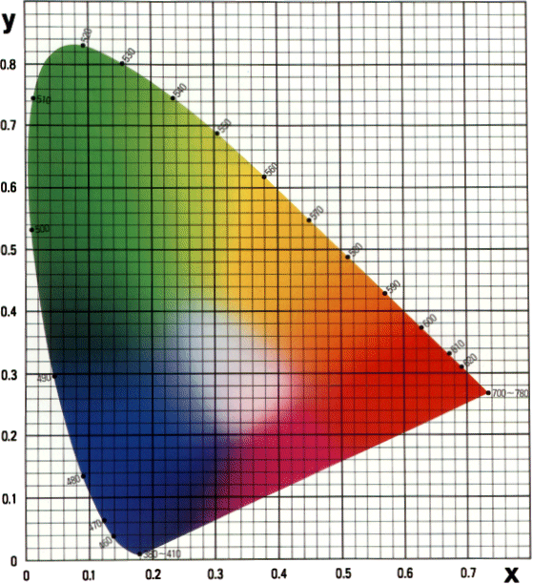
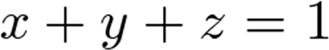
CIE Chromaticity Diagram (1931)
•For simplicity, we often project to the 2D plane
•Also normalize
•Note: Inside horseshoe visible, outside invisible to eye
Note: Look up x, y
Calculate z as 1 – x - y

Slide 26
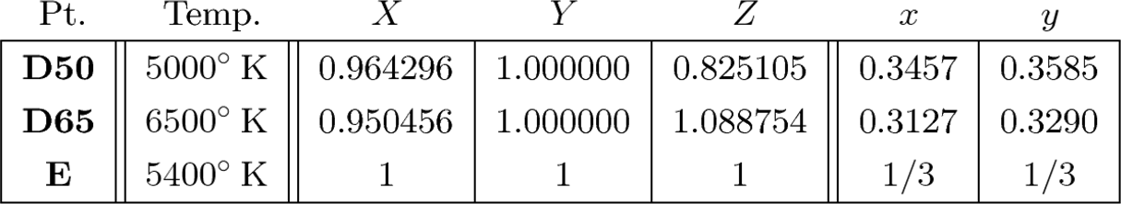
Standard Illuminants
Central goal of CIE chart is the quantitative measurement of colors in physical reality
CIE specifies some standard illuminants for many real and
hypothetical light sources
Specified by spectral radiant power distribution and correlated color temperature
D50: natural direct sunlight
D65: Indirect daylight, overcast sky

Slide 27
CIE uses
Find complementary colors:
equal linear distances from white in opposite directions
Measure hue and saturation:
Extend line from color to white till it cuts horseshoe (hue)
Saturation is ratio of distances color‐to‐white/hue‐to‐white
Define and compare device color gamut (color ranges)
Problem: not perceptually uniform:
Same amount of changes in different directions generate perceived difference that are not equal
CIE LUV, L*a*b* ‐ uniform

Slide 28
CIE L*a*b*
Main goal was to make changes in this space linear with respect to human perception
Now popular in high‐quality photographic applications
Used in Adobe photoshop as standard for converting between different color spaces
Components:
Luminosity L
Color components a* and b* which specify color hue and saturation along green‐red and blue‐yellow axes
All 3 components are measured relative to reference white
Non‐linear correction function (like gamma correction) applied

Slide 29
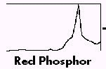
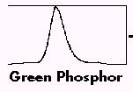
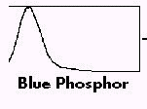
Device Color Gamuts
Since X, Y, and Z are hypothetical light sources, no real device can produce the entire gamut of perceivable color
Depends on physical means of producing color on device
Example: R,G,B phosphors on CRT monitor

Slide 30
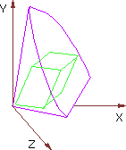
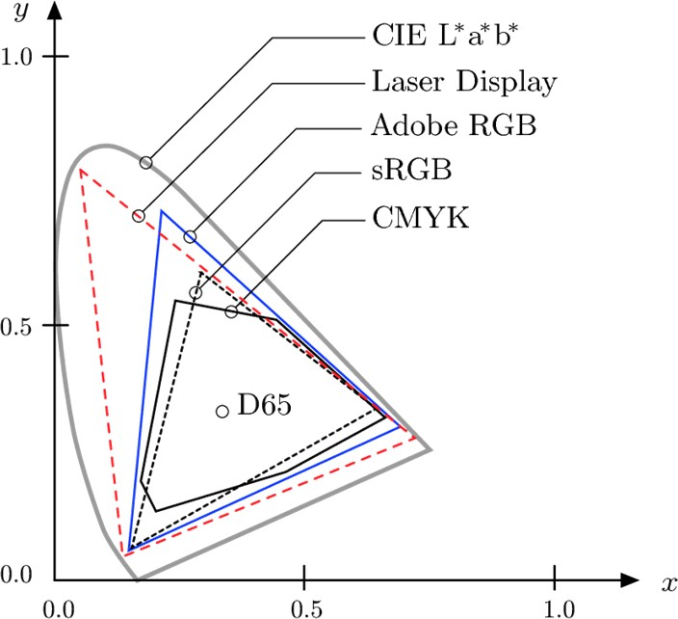
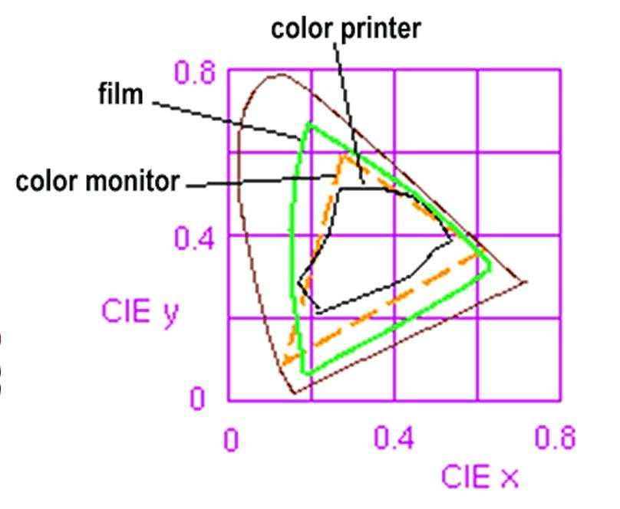
Device Color Gamuts
The RGB color cube sits within CIE color space
We can use the CIE chromaticity diagram to compare the gamuts of various devices
E.g. compare color printer and monitor color gamuts

Slide 31
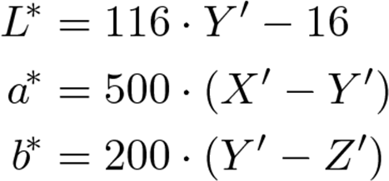
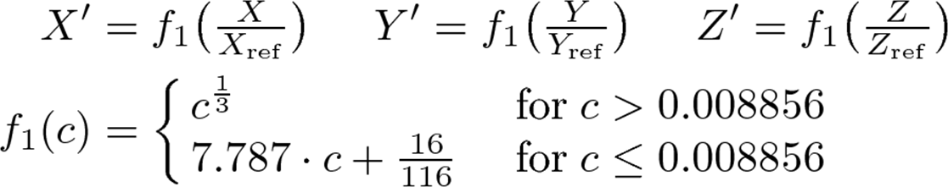
Transformation CIE XYZ to L*a*b*
Current ISO Standard 13655 conversion
where
Usually, standard illuminant D65 is specified as reference ^{(X}ref^{, Y}ref^{, Z}ref⁾
Possible values of a* and b* are in range [‐127, +127]

Slide 32
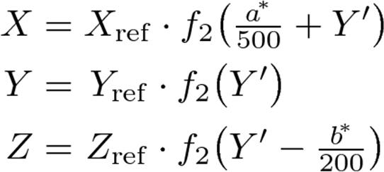
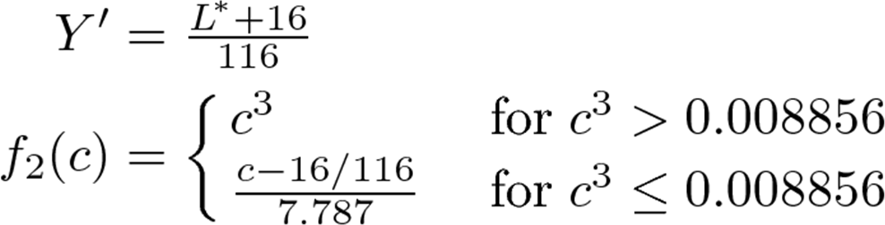
Transformation L*a*b* to CIE XYZ
Reverse transformation from L*a*b* space to XYZ is
where

Slide 33
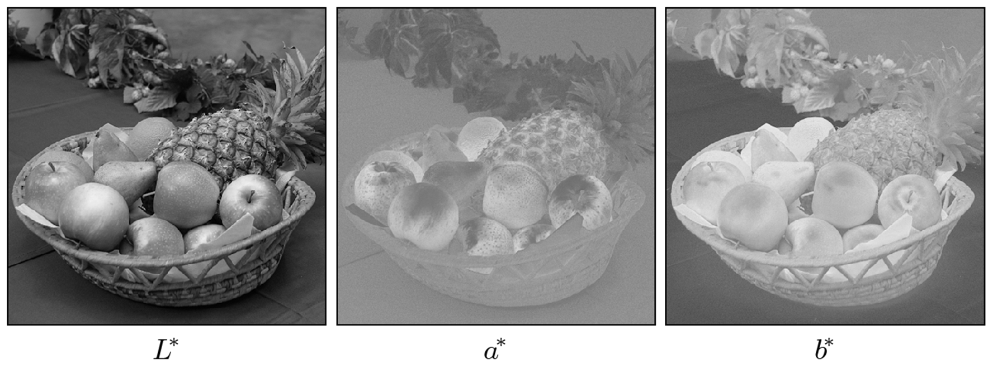
Example of L*a*b* Components

Slide 34
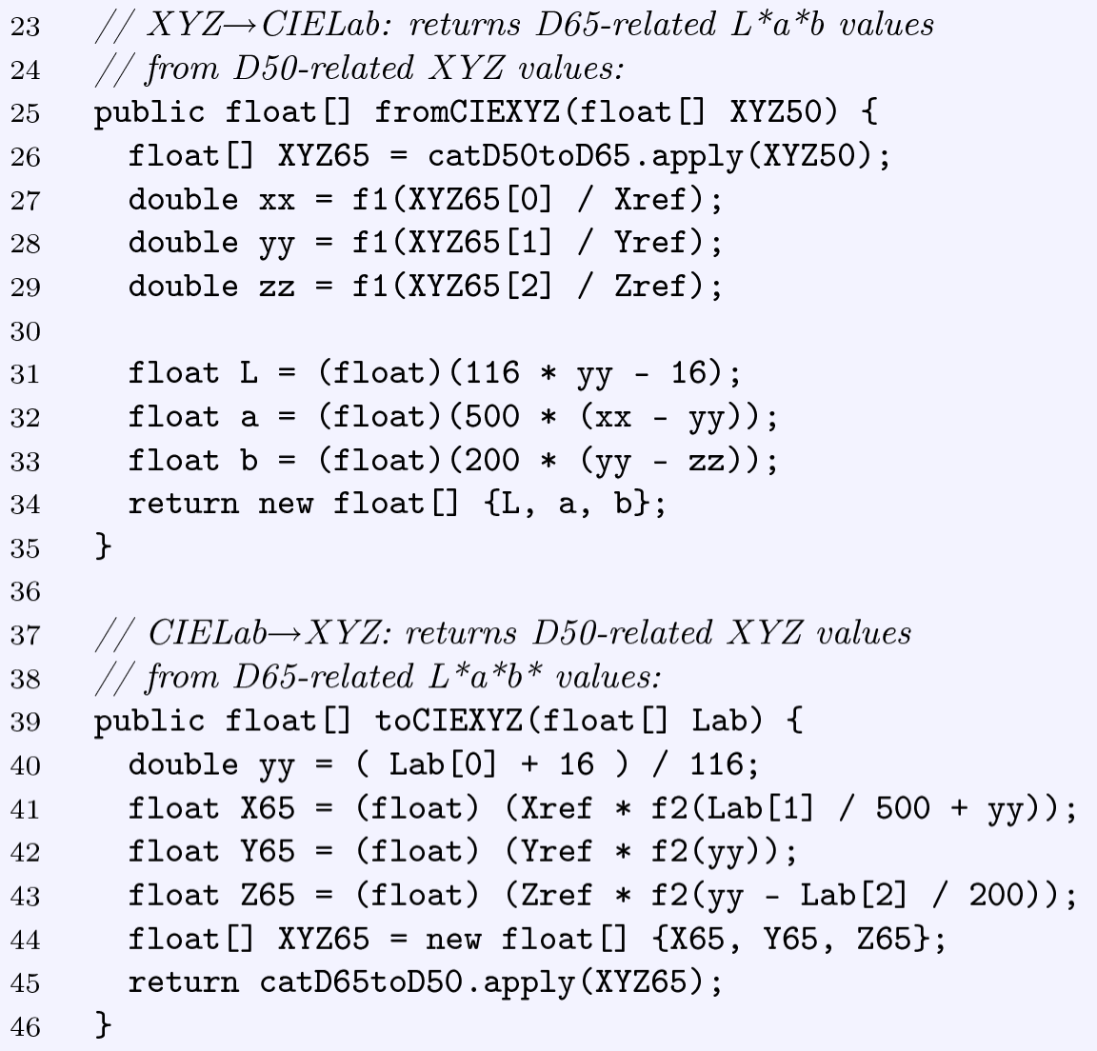
Code for XYZ to L*a*b*
and L*a*b* to XYZ Conversion

Slide 35

Measuring Color Differences
Due to its uniformity with respect to human perception, differences between colors in L*a*b* color space can be determined as euclidean distance

Slide 36
sRGB
For many computer display‐oriented applications, use of CIE color space may be too cumbersome
sRGB
developed by Hewlett Packard and Microsoft
has relatively small gamut compared to L*a*b*
Its colors can be reproduced by most computer monitors
De Facto standard for digital cameras
Several image formats (EXIF, PNG) based on sRGB

Slide 37



Transformation CIE XYZ to sRGB
First compute linear RGB values as
Where
Next gamma correct linear RGB values

Slide 38



Transformation sRGB to CIE XYZ
First linearize R’ G’ B’ values as
With
Linearized RGB then transformed to XYZ as

Slide 39

Adobe RGB
Small gamut limited to colors reproducible by computer monitors is a weakness of sRGB
Creates problems in areas such as printing
Adobe RGB similar to sRGB but with much larger gamut
sRGB gamut
Adobe RGB gamut

Slide 40
Chromatic Adaptation
Human eye adapts to make color of object same under different lighting conditions
E.g. Paper appears white in bright daylight and under flourescent light
CIE color system allows colors to be specified relative to white point, called relative colorimetry
If 2 colors specified relative to different white points, they can be related to each other using chromatic adaptation transformation (CAT)

Slide 41

XYZ Scaling
Simplest chromatic adaptation method is XYZ scaling
Basically, color coordinates multiplied by ratios of corresponding white point coordinates
For example to convert colors from system based on white point W₁ = D65 to system relative to W₂ = D50
Another alternative is Bradford adaptation

Slide 42
Colorimetric Support in Java
sRGB is standard color space in Java
Components of color objects and RGB color images are color corrected

Slide 43
Statistics of Color Images
Task: Determine how many unique colors in a given image
Approach 1: Create histogram, count frequency of each color
Not efficient since for 24‐bit image, there are 2²⁴ = 16,777,216 colors
Approach 2: Put pixels in array, then sort
Similar colors next to each other
We can then count the number of transitions between neighboring colors
Much more efficient than histogram approach if many repeated colors

Slide 44
Color Histograms
When applied to object of type ColorProcessor, built‐in ImageJ method getHistogram( ), simply counts intensity of corresponding gray values
Another alternative: compute individual intensity histograms of 3 color channels
Downside: does not give information about actual colors in image
A good alternative: 2D color histograms

Slide 45


2D Color Histograms
Define:
Note: * denotes arbitrary component value
Resulting 2D histograms are independent of original image size, easily visualized

Slide 46

Example: Combined Color Histogram

Slide 47
Color Quantization
True color can be quite large in actual description
Sometimes need to reduce size
Examples:
Convert 24‐bit TIFF to 8‐bit TIFF
Take a true‐color description from database and convert to web image format
Replace true‐color with “best match” from smaller subset
Quantization algorithms:
Uniform quantization
Popularity algorithm
Median‐cut algorithm
Octree algorithm

